Slide 1





















SwarmGenomics Genome Visualisation with Circos
ATGCTTCGCGAACGTACGTCGCGAACATTATGCTTCGCGAACGTACGTACGTAGGT

Slide 2
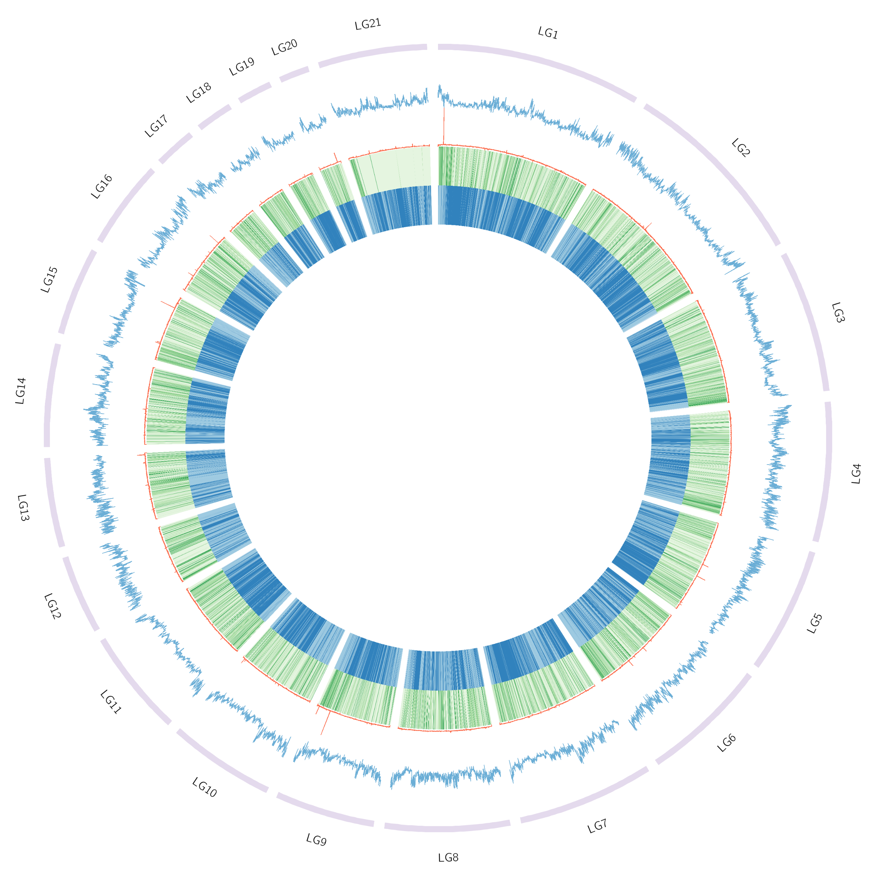
Circos plot
Developed for comparative genomics (e.g., human vs. mouse)
Scales well to whole genomes or large scaffolds
Circular representation of genomic data
Supports multiple data tracks: links, histograms, heatmaps, etc.

Slide 3
Genomic Features to Plot
Scaffold Lengths
GC Content
Coverage (read depth)
Heterozygosity
Repeat Content

Slide 4
Karyotype = scaffolds
The foundation
Anchors other data
Typically the chromosomes
Choose ~20 longest
Naming optional
As LGs = linkage groups
NCBI for actual chromosome names

Slide 5
GC Content
The proportion of guanine (G) and cytosine (C) bases in the DNA within each bin
GC content affects sequencing performance and gene density
Regions of high or low GC can indicate specific biological functions or biases
Shown as a line plot

Slide 6
Coverage
How many reads map to different regions of the genome
Gives information on
Data quality
Potential duplications
Structural variations
etc.
Shown as a line plot

Slide 7
Heterozygosity
The number of positions with heterozygous variants (i.e., where both alleles differ)
Reflects genetic diversity
Can indicate areas of high recombination or selection
Can be used for sex identification
Males (XY):
Low heterozygosity across most of X
Higher heterozygosity in PAR region
Females (XX):
Consistent heterozygosity across X
Shown as a heatmap

Slide 8
Repeat Content
The amount of repetitive DNA in each bin
Repeats are essential in genome evolution and structure but can complicate analysis
High repeat density often correlates with genome instability or assembly challenges
Shown as a heatmap

Slide 9
12. Genome Visualisation
https://github.com/AureKylmanen/Swarmgenomics/blob/main/12.%20Genome%20Visualisation.md

Slide 10

12. Genome Visualisation
1. Select 20 largest scaffolds
(or the actual number of chromosomes in your species, you can check if info available on https://www.ncbi.nlm.nih.gov/datasets/genome/)
Change reference.fna.fai according to your file name

Slide 11
12. Genome Visualisation
2. Generate karyotype file
You can edit:
The colour of the scaffold/karyotype track (currently lila)
How the names appear (currently LG1 etc.)
Can change to actual scaffold names
Can also be edited afterwards manually
vim karyotype.txt
Or actual scaffold names:

Slide 12
12. Genome Visualisation
3. Generate bins to sort your data

Slide 13

12. Genome Visualisation
4. Get coverage information
This will take a bit longer
Create text file

Slide 14
12. Genome Visualisation
5. Get GC content information

Slide 15
12. Genome Visualisation.md
6. Get repeat content information
Full command on GitHub

Slide 16
12. Genome Visualisation
7. Get heterozygosity values
Run each line separately
The first command takes a bit longer

Slide 17
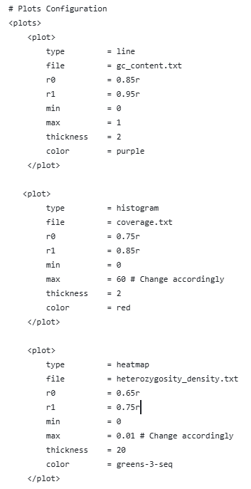
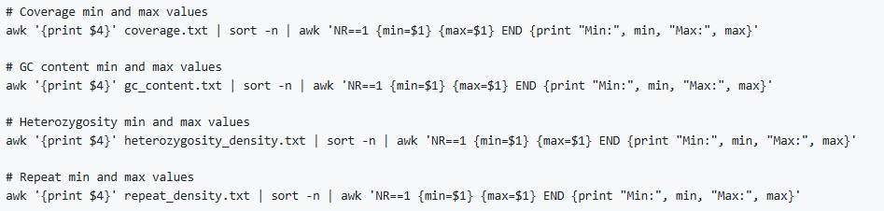
12. Genome Visualisation
8. Edit circos.conf
Download circos.conf from GitHub
Edit colours if you like
https://circos.ca/documentation/tutorials/configuration/colors/images
Change the min and max values if needed

Slide 18
12. Genome Visualisation
9. Run circos.conf
Change the path to the circos installation accordingly
You can edit the circos.conf and rerun to change any elements of the plot

